Slide 1
BARC Tube Bending Week 4

Slide 2
Checklist
Process: Manual Edge detection Smoothing edges Fitting lines to straight sections Angle Calculation Part 1 ( Bends 1 & 2) Part 2 ( Bends 2,3 & 4) Automated Edge detection Smoothing edges Fitting lines to straight sections Angle Calculation Part 1 ( Bends 1 & 2) Part 2 ( Bends 2,3 & 4) | Varying Parameters: Background Color Background Brightness Distance to LED box Height of camera Camera Orientation Lighting (Front vs Back) Different cameras/lenses Adding noise (non-ideal lighting conditions) No. of Cameras

Slide 3
Last Week Result: Process
Setup image
Image subtraction
Binarized
Edge Detection
Line fitting
Edge Detection
Line Fitting to straight sections of edges (4 lines)
Angle calculation between the fitted lines
Tube image
Angle Calculation

Slide 4
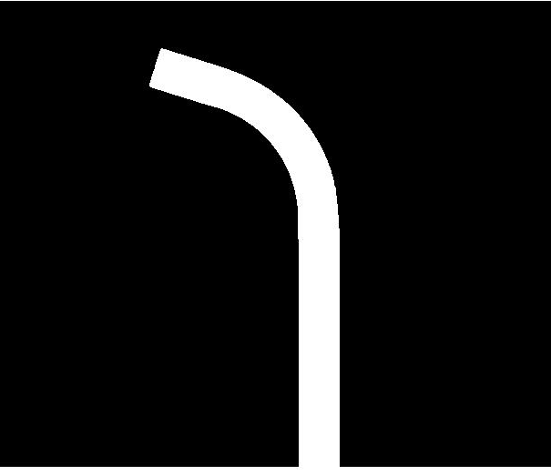
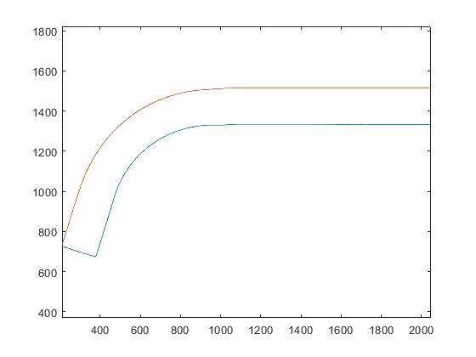
Last Week Result: P1B1
Least error edge - Left
Error value - 0.0101 deg
Binarized Image
Edge Detection plot

Slide 5
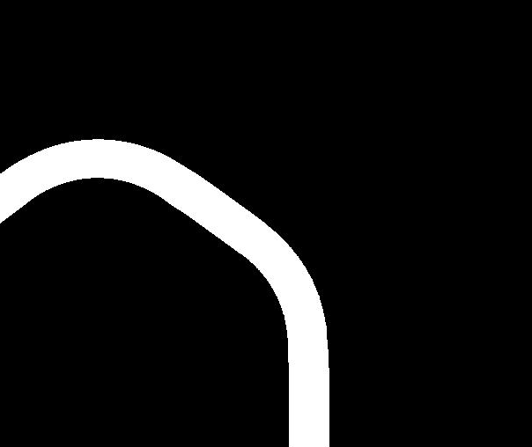
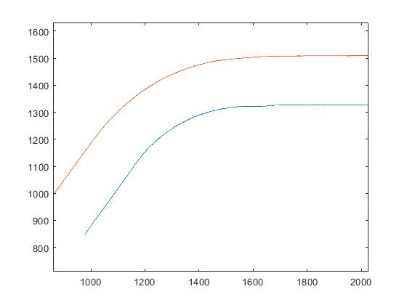
Last Week Result: P1B2
Least error edge - Right
Error value - 0.5170 deg
Binarized Image
Edge Detection plot

Slide 6

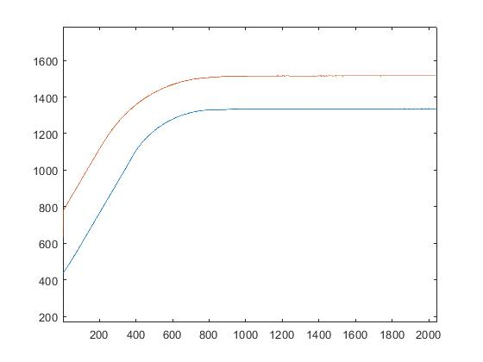
Last Week Result: P2B2
Least error edge - Left
Error value - 0.0022 deg
Binarized Image
Edge Detection plot

Slide 7

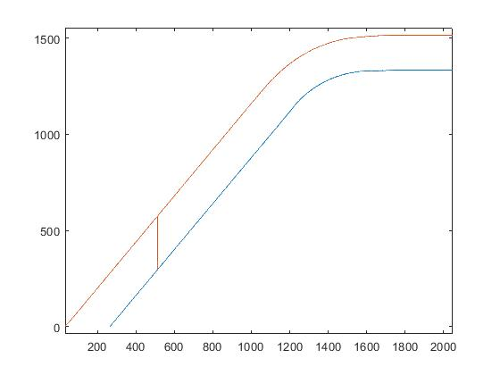
Last Week Result: P2B3
Least error edge - Left
Error value - 0.0277 deg
Binarized Image
Edge Detection plot

Slide 8

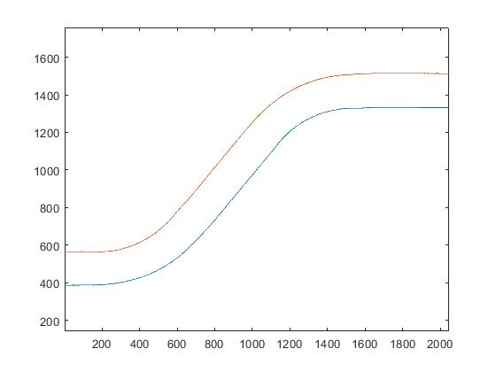
Last Week Result: P2B4
Least error edge - Right
Error value - 0.0432 deg
Binarized Image
Edge Detection plot

Slide 9
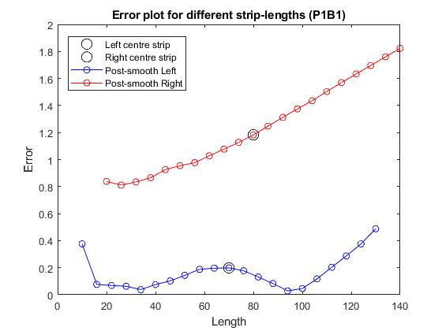
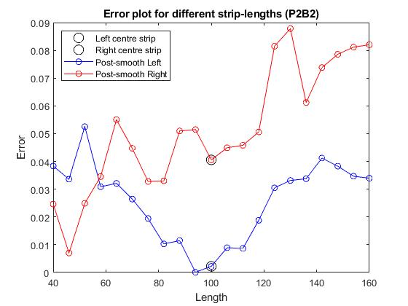
Last Week Result: Angle Error plots
Changing the length of the data points gives us an idea of the angle error we get
No general trend observed because it depends on the edge roughness and camera resolution

Slide 10
New Approach: Fitting Error
Start from the middle of the edge data points.
Increase the number of points for line fitting, get the fitting error and the angle error.
Hopefully the minimum angle error should be corresponding to the minimum fitting error.

Slide 11
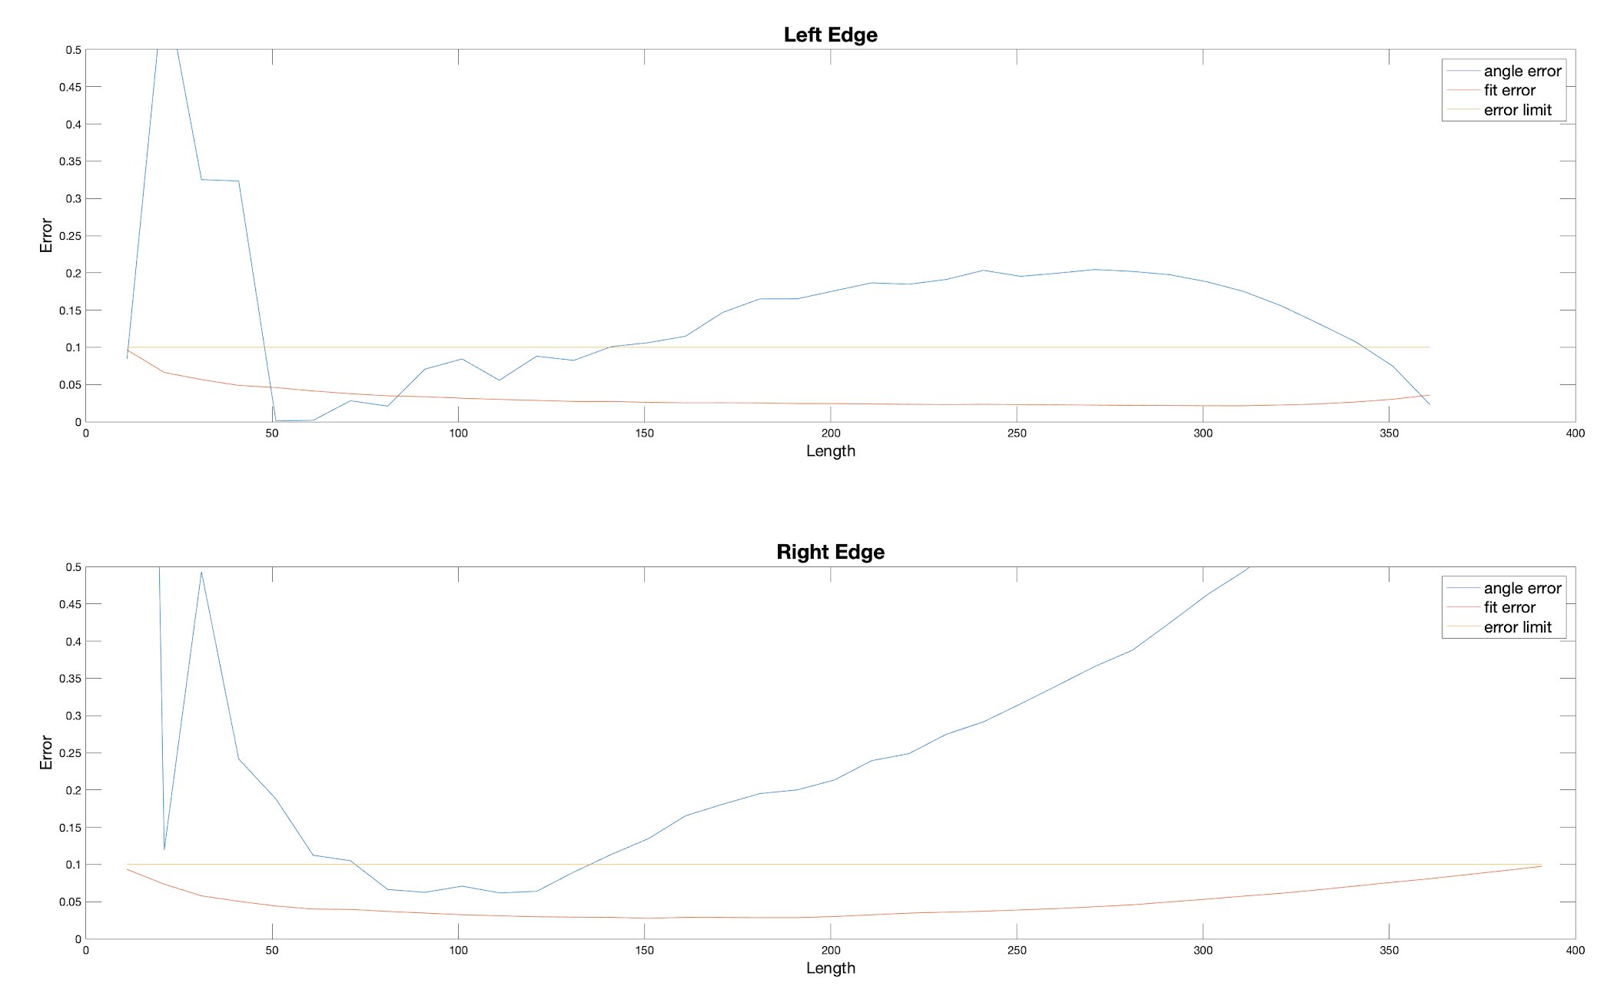
New Approach: Fitting Error
P1B1

Slide 12
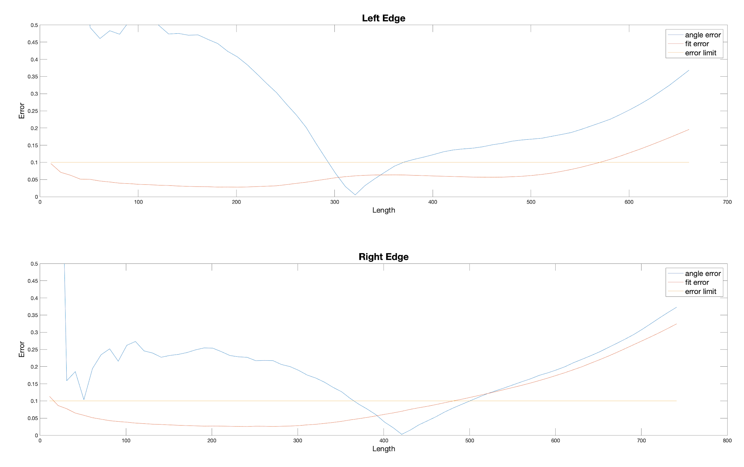
New Approach: Fitting Error
P1B2

Slide 13
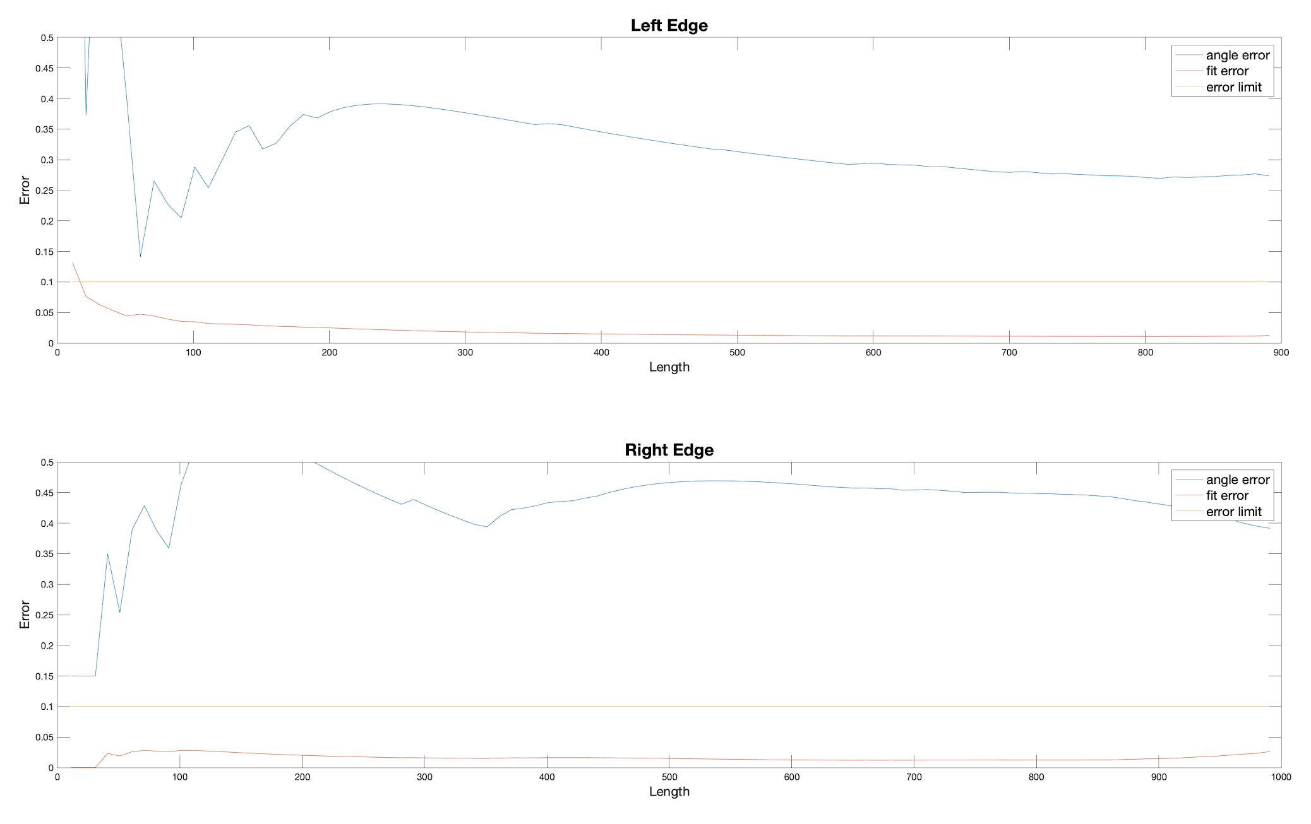
New Approach: Fitting Error
P2B1

Slide 14
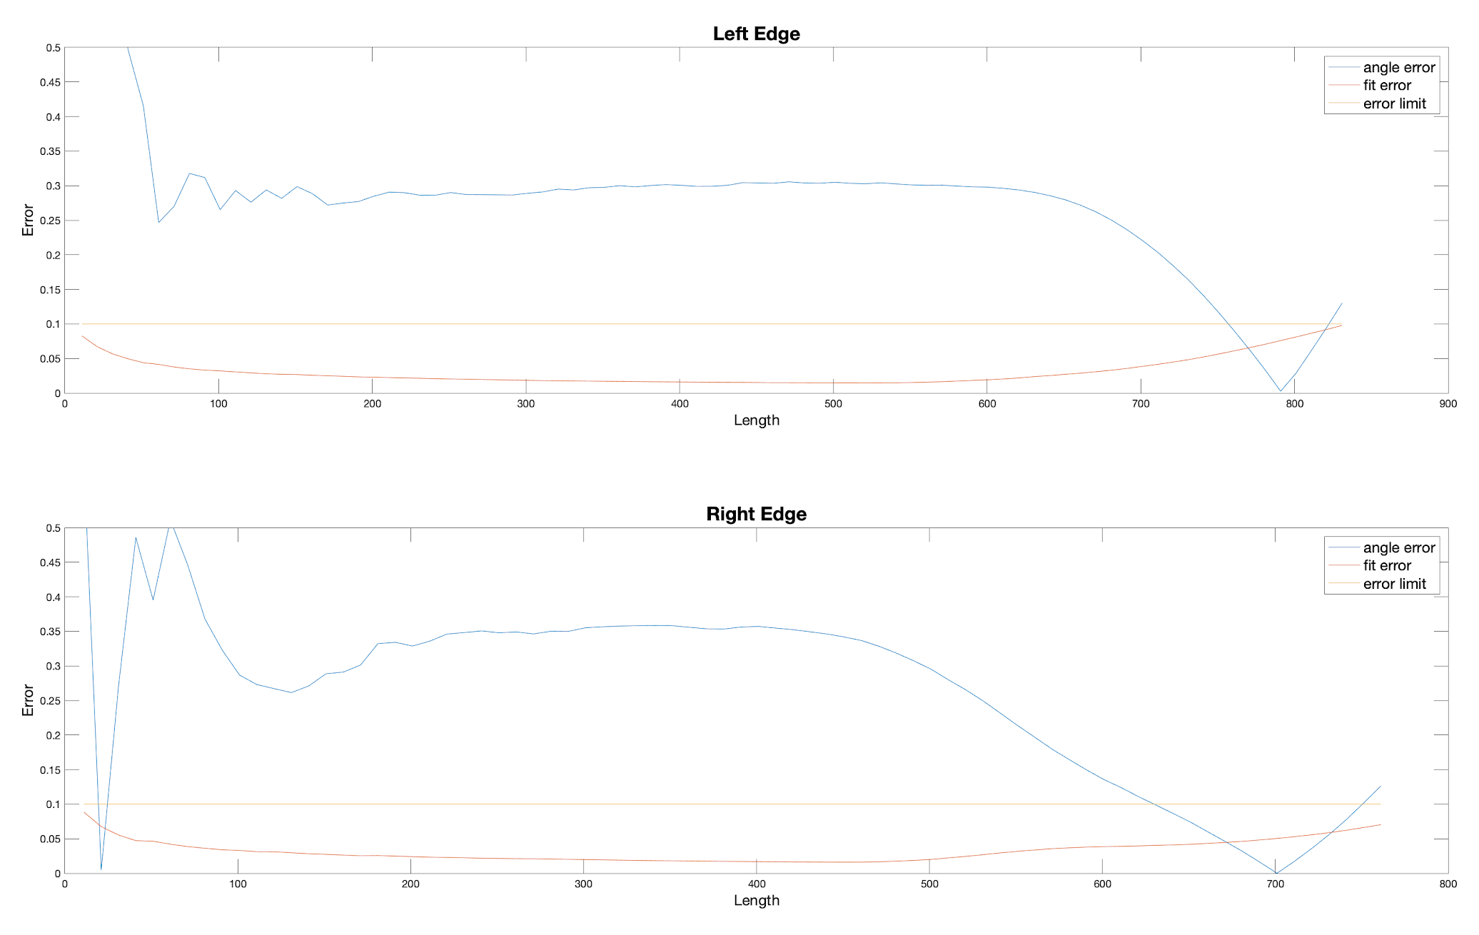
New Approach: Fitting Error
P2B2

Slide 15
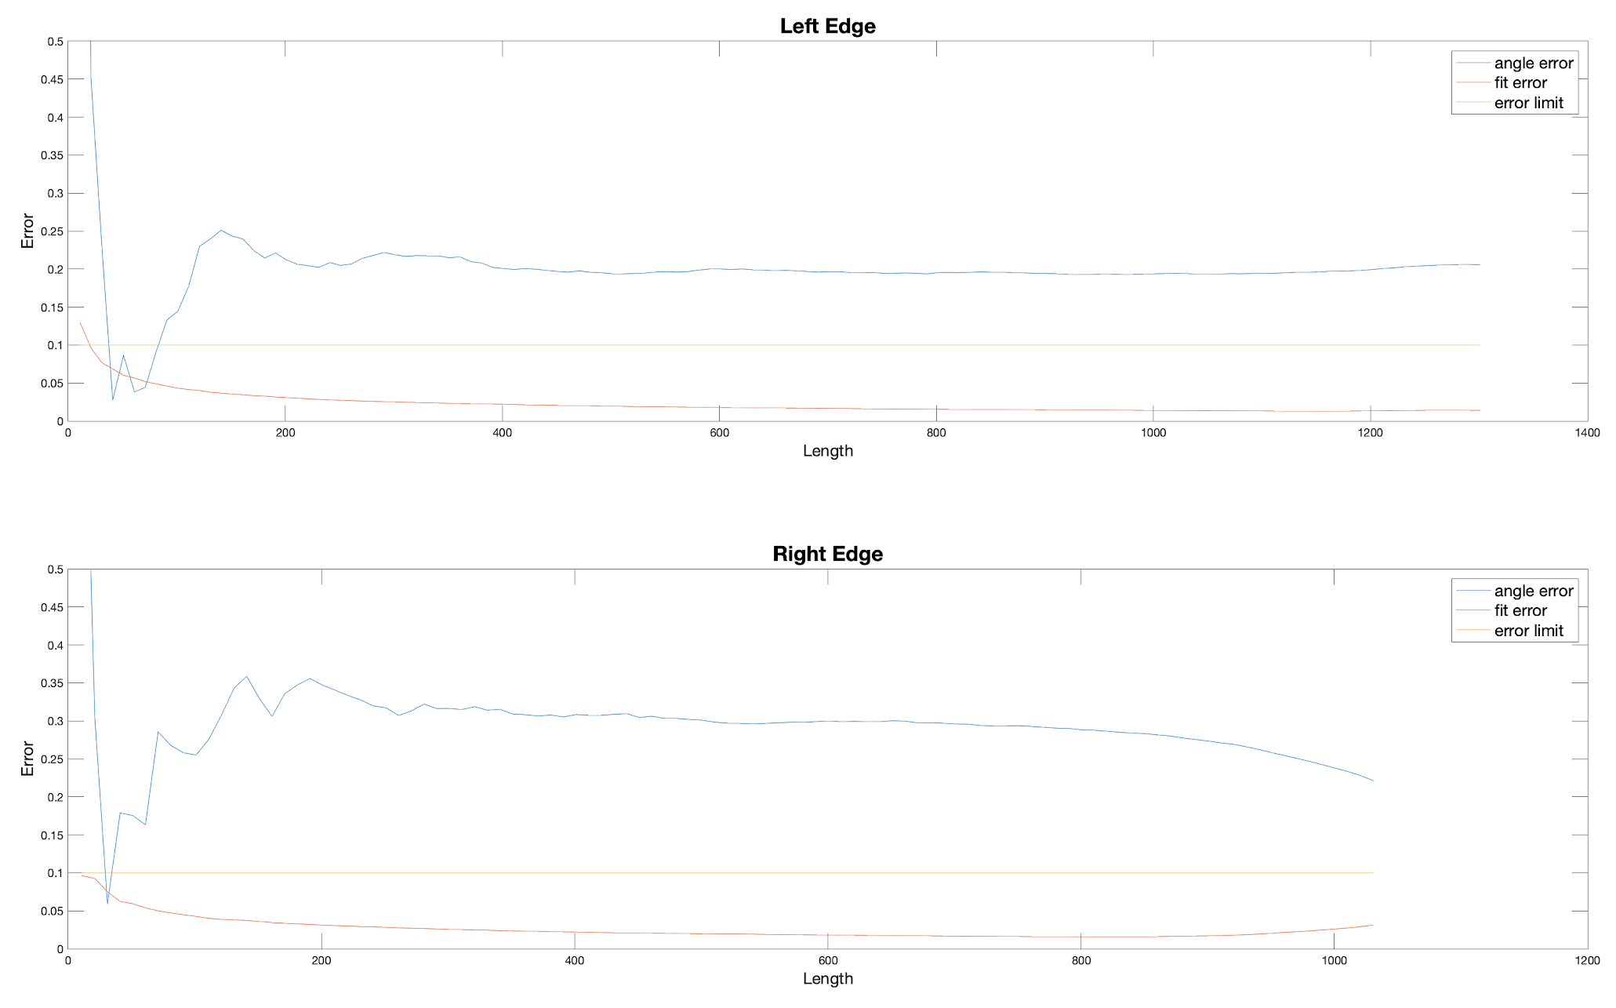
New Approach: Fitting Error
P2B3

Slide 16
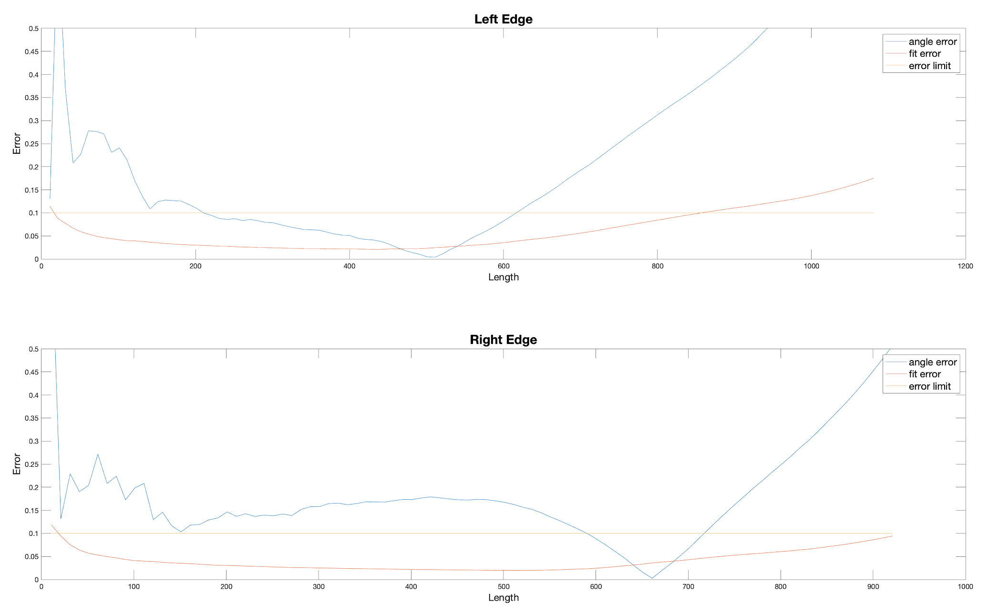
New Approach: Fitting Error
P2B4

Slide 17
Result
The left edge gives less error than the right edge in most cases.
The number of data points, the fitting error and the angle error seems irrelevant with each other.
Right now it is safe to say that 0.5 deg accuracy can be reached.

Slide 18
Perfect Line Test
For different angles, we draw a corresponding line on the image. Then use these data points for line fitting. We found that even for the perfect line, the error was not negligible.

Slide 19
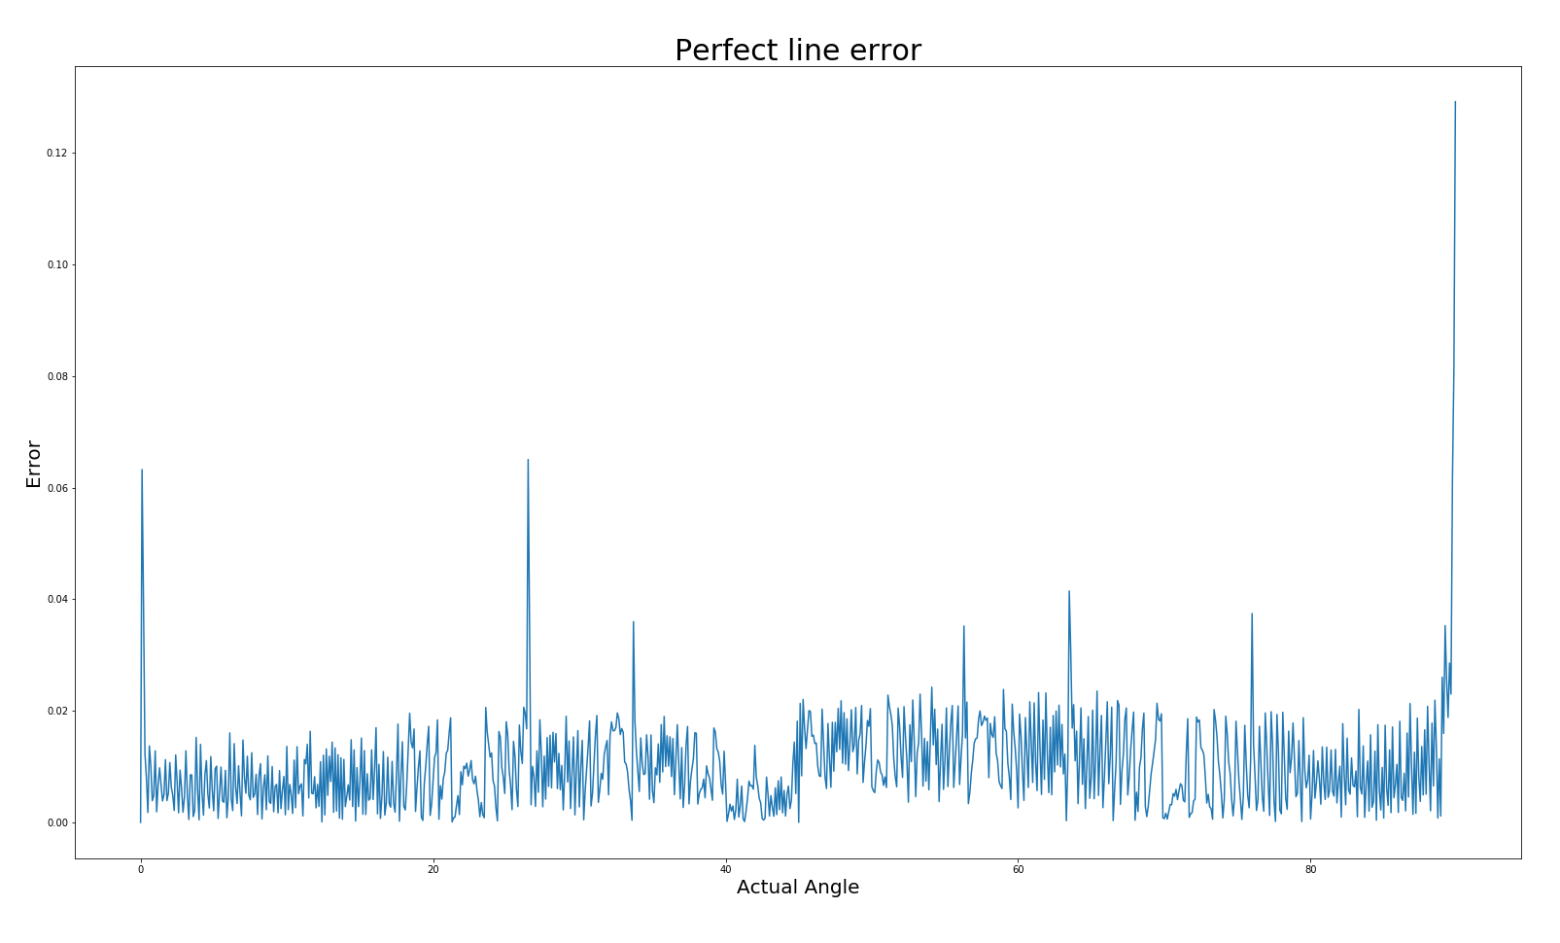
Perfect Line Test

Slide 20
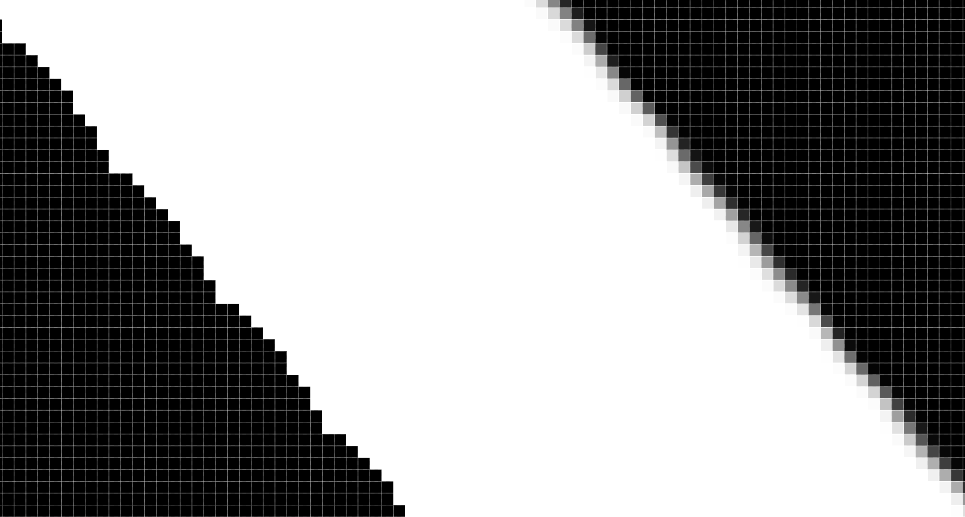
Aliased Image
Since the resolution of an image is finite, it cannot represent a “perfect” straight line.
The fitting error exists even for perfect line.

Slide 21
Future Work
A camera with higher resolution is needed.
Draw lines with different angles and find the number of pixels it intersects with the bend. Choose the one with the largest number.

